Slide 1

Automated, Live Fact-Checking
Chengkai Li
Associate Professor, Department of Computer Science and Engineering
Director, Innovative Database and Information Systems Research (IDIR) Laboratory
University of Texas at Arlington

Slide 2
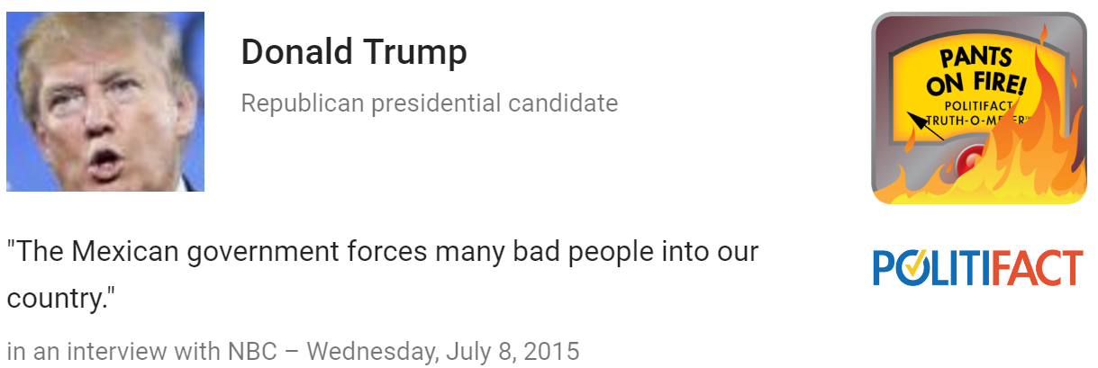
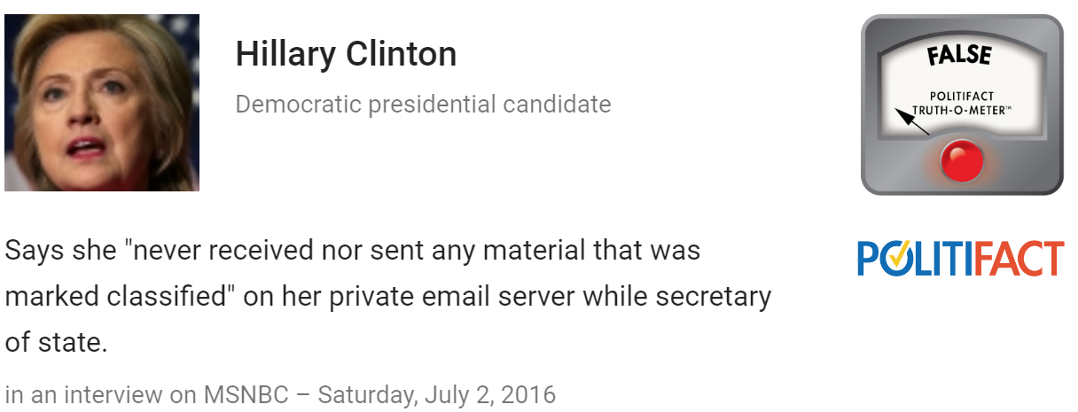
People Make Claims All the Time
http://www.politifact.com/truth-o-meter

Slide 3
Fact-checking is Challenging
Limited resources, time-consuming tasks
96 active fact-checking sites in 2016 (PolitiFact .com, CNN, Washington Post, …)
Several hundred professional fact-checkers
One fact-check oftentimes takes one day
vs.
Fast-spreading falsehoods and half-truths on the web and social network

Slide 4


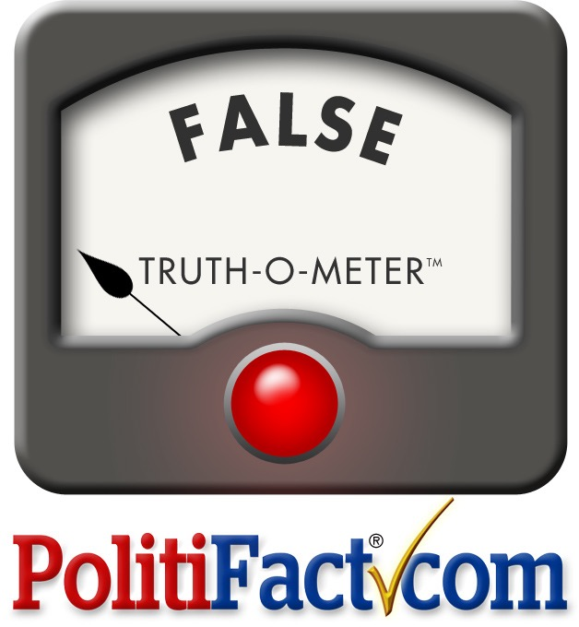

The Holy Grail: Automated, Live Fact-Checking
Source: Bill Adair

Slide 5



ClaimBuster
collaborators
repository of fact-checks by professionals
claimed detected and ranked by check-worthiness
debates
interviews
speeches
political ads
social media
web
news
matched existing fact-checks: delivered via browser extensions, mobile and smart-TV apps
funding
new factual claims:
solicit analyses from professionals; algorithmic fact-checking
Notes:
Dr. Chengkai Li has been on the frontier of computational journalism research in the past several years. His team has worked on multiple projects in this area, in collaboration with computer scientists and journalism experts from UTA, Duke, Google Research, and Stanford. Particularly Dr. Li has led the development of two systems, with support from the National Science Foundation, the Knight Foundation, and HP Labs.
ClaimBuster aims to monitor live political discourses, social media, web and news to catch factual claims, detect matches with a curated repository of fact-checks, and deliver the matches instantly to viewers; for professional fact-checkers, ClaimBuster will suggest new claims worth checking and provide computational tools that help the fact-checking process.
FactWatcher is a system that helps journalists identify from real-world events data-backed, attention-seizing facts which serve as leads to news stories.

Slide 6
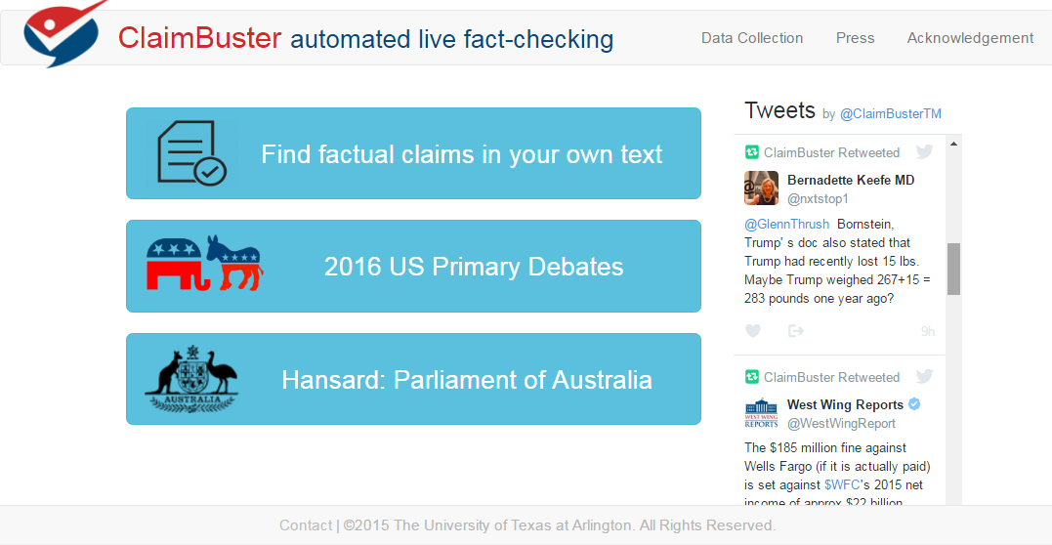
Notes:
Still in development, the prototype of ClaimBuster was tested in real-time during recent Democratic and Republican debates. When there is no debate, ClaimBuster is constantly monitoring Twitter and retweeting important factual claims it finds.

Slide 7
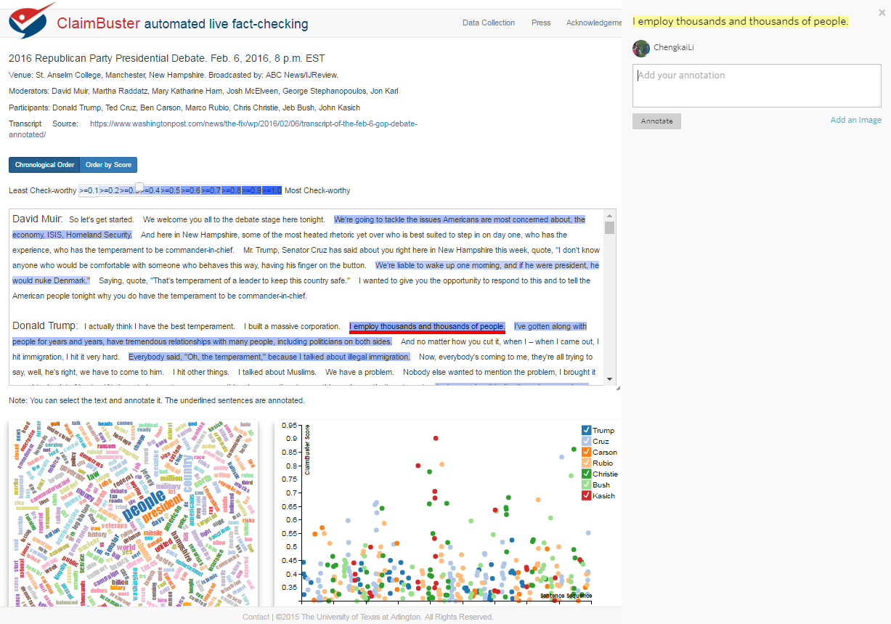
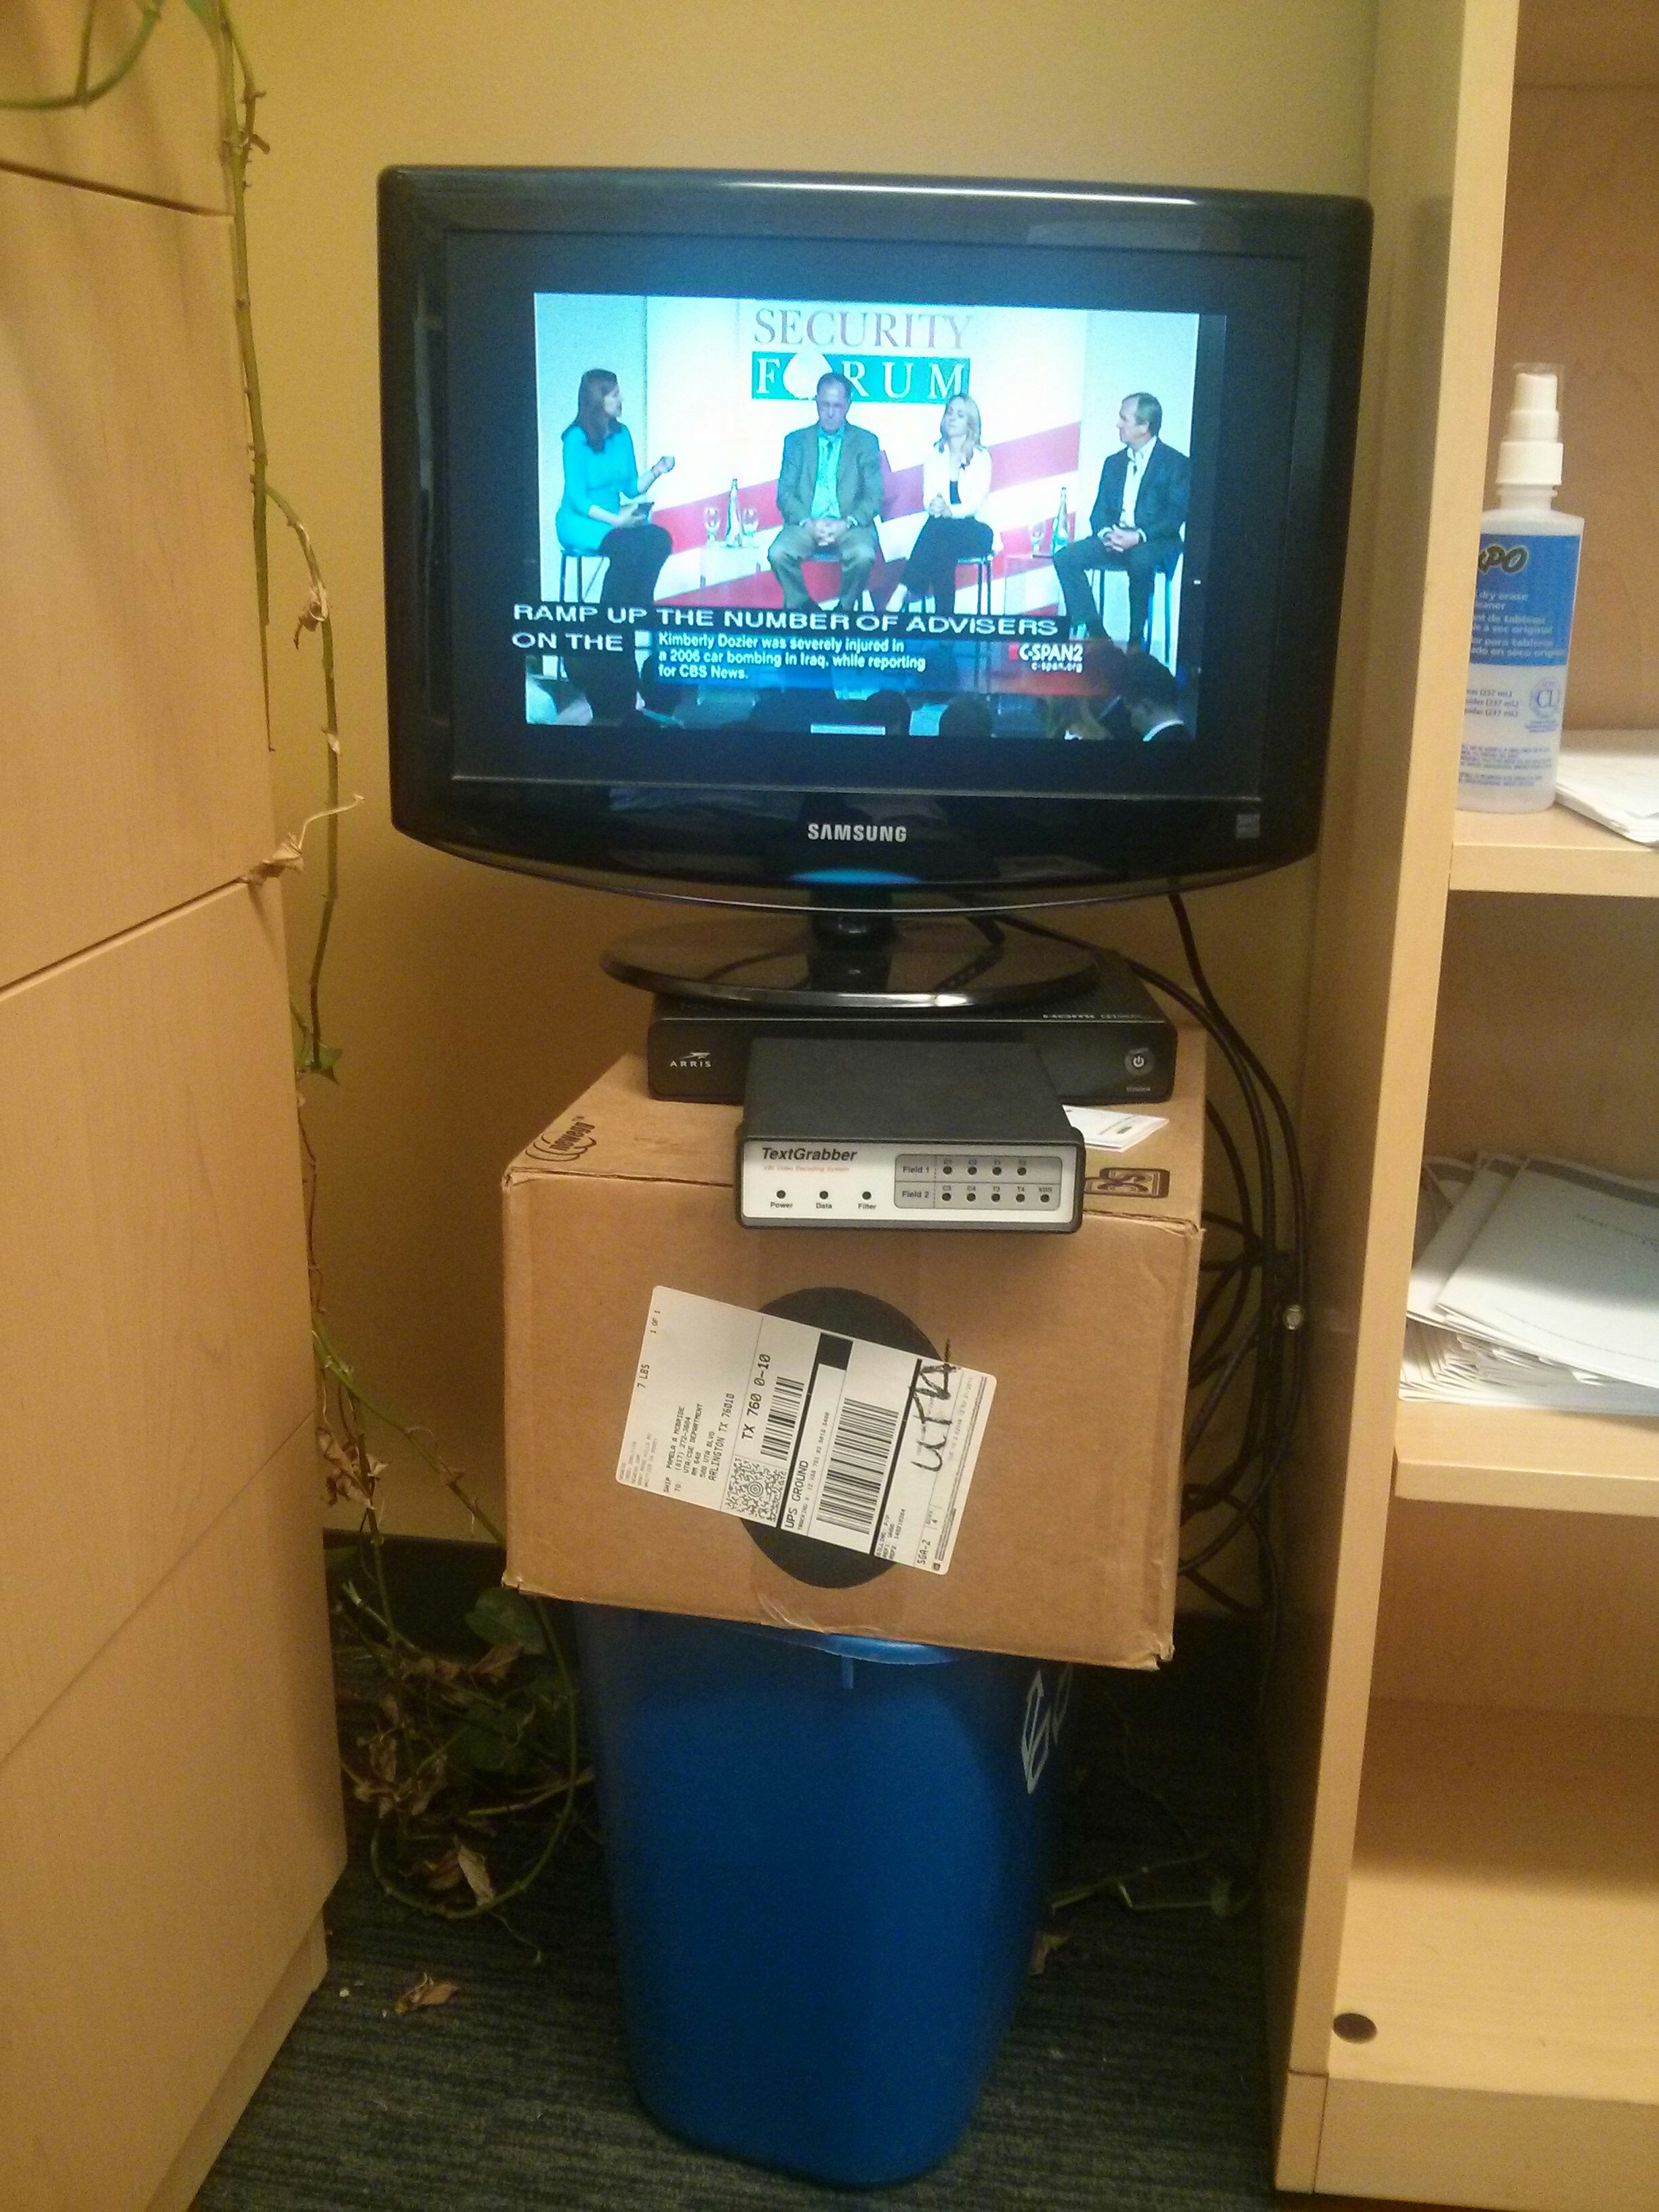
Live Coverage of Debates
Closed-captions devices
Notes:
Closed captions of the debates on live TV broadcasts were fed to ClaimBuster, which immediately scored each sentence and posted top ones to the project's website and Twitter account. Post-hoc analysis of the claims checked by professional fact-checkers at CNN, PolitiFact.com and FactCheck.org shows that they were scored high by ClaimBuster, indicating a highly positive correlation between ClaimBuster and professionals in deciding which claims are check-worthy.
This project is making strides toward the team's quest for the "Holy Grail" – a completely automated fact-checking machine that detects and verifies or disputes claims found in all kinds of sources. The project has received wide recognition in the fact-checking community and substantial media coverage.

Slide 8


Media Coverage
"... perhaps the biggest development to date ..."
"The most advanced generalised automatic claim spotting ..."
"... an intriguing glimpse into the role machines, bots and artificial intelligence will play in journalism’s future."
"... a pretty useful guide for journalists and those members of the public ..."
"... ClaimBuster and its successors in keeping voters informed and politicians honest."
"Fact-checking is increasingly being bolstered by tools like ClaimBuster."
Notes:
Closed captions of the debates on live TV broadcasts were fed to ClaimBuster, which immediately scored each sentence and posted top ones to the project's website and Twitter account. Post-hoc analysis of the claims checked by professional fact-checkers at CNN, PolitiFact.com and FactCheck.org shows that they were scored high by ClaimBuster, indicating a highly positive correlation between ClaimBuster and professionals in deciding which claims are check-worthy.
This project is making strides toward the team's quest for the "Holy Grail" – a completely automated fact-checking machine that detects and verifies or disputes claims found in all kinds of sources. The project has received wide recognition in the fact-checking community and substantial media coverage.

Slide 9

Commercialization

Slide 10


Thank You! Questions?
http://ranger.uta.edu/~cli
cli@uta.edu
Prototype
http://idir.uta.edu/claimbuster
You are invited to contribute
http://bit.ly/claimbusters

